Slide 1
Brooks DeBartolo Collegiate High School
Course Progression Plan
2023-2024

Slide 2
BDCHS English Language Arts Pathways to Success
9th grade
10th grade
11th grade
12th grade
English 1 Honors
English 2 Honors
English 3 Honors
English 4 Honors
Grade 9
Prereq: English 1
Grade 10
Prereq: English 2
Grade 11
Prereq: English 3
Grade 12
OR
OR
AP English Lang
AP English Lit
Prereq: AP Lang (≥B)
Grade 12
ELA Graduation Requirements:
4 credits in core English courses (listed here).
For competitive college admissions, AP Lang and AP Lit are highly recommended.
Prereq: English 2 (≥B)
Grade 11 recommended
OR
OR
ENC 1101/1102
Prereq: ENC 1101 (≥B)
Grade 11 or 12
(contingent on availability
ENC 1101
Prereq: English 2 (≥B)
Grade 11 or 12
(contingent on availability)
OR
LIT 2000/2110
Prereq: ENC 11101/1102 (>B)
Grade 12
(Contingent on availability)

Slide 3
BDCHS Mathematics Arts Pathways to Success
Algebra 1 Honors
No prerequisites
Reqs. for Standard Diploma:
4 credits in Mathematics that must include Algebra 1 and Geometry.
Must pass Algebra 1 EOC.
Reqs. for Scholar Designation:
Earn 1 credit in Algebra 2.
Pass Geometry EOC.
Earn 1 credit in Precalculus, Calculus, or Statistics.
Geometry Honors
Prereq: Algebra 1
Liberal Arts Track
Options
Precalculus Honors
Algebra 2 Honors
Math for College Algebra H
STEM Track
Options
Prereq: Algebra 2 (≥C)
SAT/ACT Prep Course
Prereq: Geometry (≥C)
SAT/ACT Prep Course
Prereq: Geometry SAT/ACT Prep Course
Math Data and Financial Literacy
Calculus Honors
Probability and Statistics H
Prereq: Alg. 1,2, and Geometry
Prereq: Precalculus +
Teacher Recommendation
Prereq: Algebra 2 OR MCR

Slide 4
BDCHS Science Choices
10th grade
11th grade AND 12th grade
9th grade
Chemistry 1 Honors
Prereq: Biology 1 (≥C)
Anatomy & Physiology Honors
Prereq: Chemistry
*Available every other year
Biology 1 Honors
No prerequisites
Graduation Requirement
Chemistry 1 Honors
Prereq: Biology 1 (≥C)
OR
Forensic Science Honors
Prereq: Biology 1 (≥C)
Environmental Science
OR
AP Environmental Science
Prereq: Chemistry
Forensic Science Honors
Prereq: Biology 1 (≥C)
Marine Science Honors
Prereq: Biology 1 (≥C)
Physics 1 Honors
OR
AP Physics
Prereq.: Algebra 2 (≥ C) (Chem 1)
OR
Reqs. for Standard Diploma:
3 credits in Science that must include Biology 1.
2 of 3 credits must have a lab component.
Reqs. for Scholar Designation:
Pass Biology EOC.
Earn 2 credits in Chemistry, Physics and/or an equally rigorous science course.
**4 science credits are recommended for competitive college admissions. **
Marine Science Honors
Prereq: Biology 1 (≥C)
Genetics
Prereq: Biology 1 (≥C)
Zoology
Prereq: Biology 1 (≥C)

Slide 5
BDCHS Social Science Choices
9th grade
10th grade
11th grade
12th grade
World Cultural Geography
World History Honors
10th grade *Graduation Requirement*
U.S. History Honors
11th grade
*Graduation Requirement*
U.S Govt Honors
& Econ Honors
12th grade
OR
OR
OR
AP U.S. History
11th grade
AP U.S Govt
& Econ Honors
12th grade
AP World History
10th grade
Social Science Graduation Requirements:
3 credits in World History (1 credit),
US History (1 credit),
U.S Government (0.5 credits), and Economics (0.5 credits).
All BDCHS Grade 9 students are enrolled in an introductory Social Science course, Pre-AP World History and Geography.
OR
OR
Dual Enrollment
AMH 2010/AMH 2020
*Must take both to equal the High School Credit*
Dual Enrollment
POS 2041/ECO 2013
*Must take both*
Grade 12

Slide 6
BDCHS Personal, Career, and School Development
9th grade
10th grade
11th grade
12th grade
Personal, Career, and School Development (PCSD) 1
Personal, Career, and School Development (PCSD) 2
Personal, Career, and School Development (PCSD) 3
Personal, Career, and School Development (PCSD) 4
Why PCSD?
Helps students develop necessary skills for everyday life.
Assist students with college and career research
Expose individuals to diverse career prospects

Slide 7
2022/2023 BDCHS CTE/STEM Pathways to Success
Why follow CTE/STEM tracks?
Certifications verify mastery of skills
Certifications can expose individuals to diverse career prospects
Students develop skills that are sought after by industries and aligned with the job market
Employers regularly use certifications as selection criteria for hiring, promotion, and/or salary increases
College credits towards degrees
Program Essentials
CS Python Fundamentals
Experimental Science 2
MSSC Certified Production Technician (CPT)
Experimental Science 3
MSSC Certified Logistics Associate/Certified Logistics Technician CLA/CTA Supply Chain Logistics

Slide 8
BDCHS World Language Pathways to Success
Spanish 1
Florida Seal of Biliteracy
Gold Seal:
Earned 4 credits in the same foreign language with a 3.0 or higher GPA AND
Level 4 or higher on Grade 10 FSA ELA.
OR
4 or higher on AP Language Exam
Silver Seal:
Earned 4 credits in the same foreign language with a 3.0 or higher GPA.
OR
3 or higher on AP Language Exam
Prereq: None
Bright Futures
World Language Requirement:
2 sequential World Language Credits in the same language.
Spanish 2
Prereq: Spanish 1
Spanish 3 Honors
4 Years of a World Language recommended for competitive college admissions.
Prereq: Spanish 2
AP Spanish Language & Culture
OR
Spanish 4 Honors
Prereq: Spanish 3 or 4, AP Course Recommendation
Prereq: Spanish 3

Slide 9
AP Capstone Courses
AP Seminar
AP Research
Grades 10 & 11
Application-based course.
The first course in the AP Capstone Diploma program. Students who are accepted into the AP Capstone program will be automatically enrolled in AP Seminar.
Since you will not know your status in the program until after Course Selection is complete, please include all alternate elective options.
Grades 11 & 12
Application-based course.
The second course in the AP Capstone Diploma program.
Students currently enrolled in AP Seminar will be automatically enrolled in AP Research next year.

Slide 10
BDCHS English/Language Arts Electives
Journalism (Yearbook)
Creative Writing
Students develop and design the BDCHS Yearbook and Phoenix Newsletters.
Application based course.
Applications DUE in April
Grades 10-12
Students develop and use writing and language skills for creative expression in a variety of literary forms. Studying and modeling a variety of genres will be emphasized at this level of creative writing.
Grades 10- 12
Literature & The Arts
Students will explore the relationship between literature and the fine arts through experiences of viewing, reading, writing, speaking and listening, and language. Emphasis will be on the varied cultural influences highlighting the major themes, issues, and topics associated throughout selected literary and artistic periods. Grades 10-12

Slide 11
BDCHS Physical Education & Other Electives
HOPE
Basketball 1/2
Reqs. for Standard Diploma:
1 credit of Physical Education to include Health*
HOPE fulfills this requirement
Recommended at Grade 9
*Graduation Requirement*
Yearlong course
No prerequisite
Physical Education
Options
Team Sports 1/2
Weight Train 1/2
Health Education
Yearlong course
No prerequisite
Yearlong course
No prerequisite
Power Weight Lifting
Driver Education (semester course)

Slide 12
BDCHS Social Science Electives
Psychology 1 / Psychology 2
Women's Studies/ Law Studies
African- American History/ Holocaust History
Introduction to the scientific exploration of the mind and human behavior.
Year-long paired* semester electives.
Grades 10-12
*Must take both courses
Study of the historical development of women in various cultures. The study of the American legal system.
Year-long paired* semester electives.
Grades 11-12
*Must take both courses
Study of the chronological development of African-Americans. The examination of the events of the Holocaust.
Year-long paired* semester electives.
Grades 11-12
*Must take both courses
AP Psychology
AP Human Geography
Year-long course.
Grades 10-12
AP Course Recommendation required.
Recommended prerequisite:
Grade 9 or 10 FSA Benchmark
Year-long course.
Grades 9-12
AP Course Recommendation required.
Recommended prerequisite:
Grade 9 or 10 FSA Benchmark

Slide 13
BDCHS Fine & Performing Arts Electives
Reqs. for Standard Diploma:
1 Credit in Fine and Performing Arts, Speech and Debate, or Practical Arts*
*Digital Info Tech fulfills this credit.
Guitar 1 / Guitar 2
Musical Arts
Options
Draw 1/ Draw 2
Yearlong course
No prerequisite
Yearlong course
No prerequisite
Keyboarding 1
Paint 1 / Paint 2
Yearlong course
No prerequisite
Band 1
Yearlong course
No prerequisite
Visual Arts
Options
Yearlong course
No prerequisite
AP 2D:Studio Art
Chorus 1
Band 5 Honors
(Advanced Band)
Prereq: Draw and Paint
Yearlong course
No prerequisite
Prereq: Band 1
Chorus 5 Honors (Advanced Chorus)
AP 2D: Drawing
Ceramics 1
Prereq: Draw and Paint
Yearlong course
No prerequisite
Prereq: Chorus 1

Slide 14
Links to Program-Specific Presentations
Dual Enrollment
AP Capstone
CTE/STEM

Slide 15
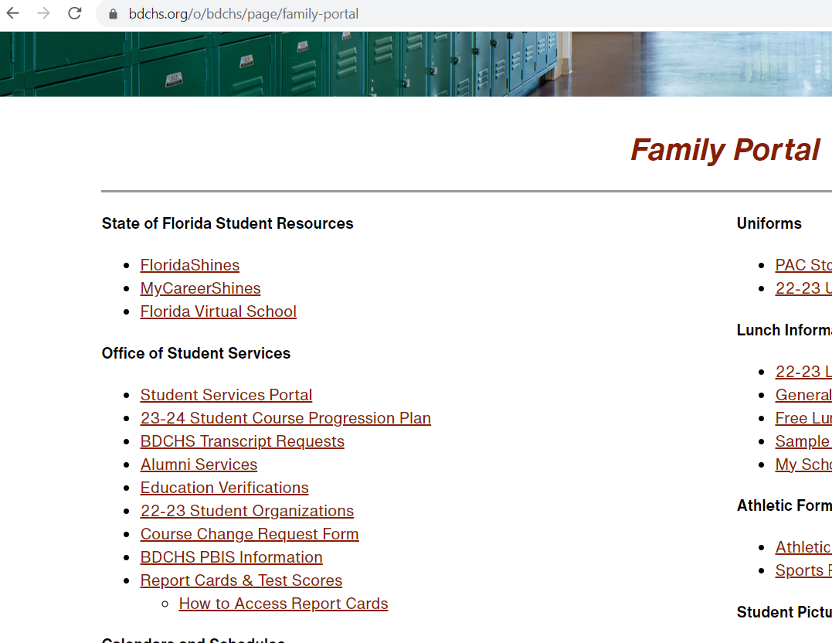
This Thursday and Friday
This powerpoint is on our family portal.
Under Office of Student Services
Counselors will be going into the classrooms on Thursday and Friday to help students submit final course selection for 2023-2024 school year.

